Slide 1
Walmart Rental Data Analysis Part 2
File created on: 6/18/2022 12:21:22 AM

Slide 2
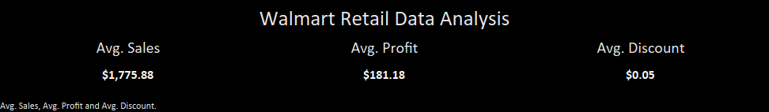

Slide 3
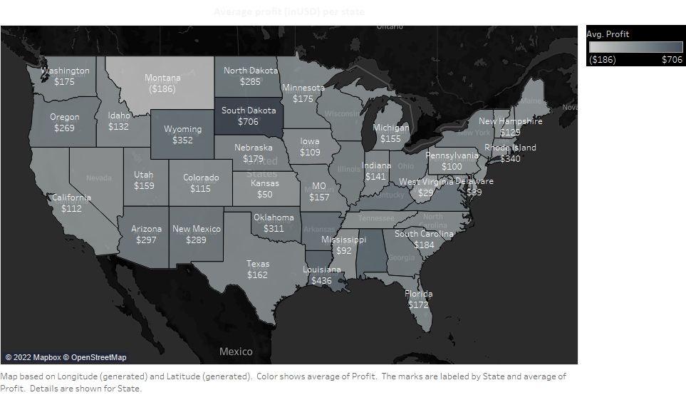

Slide 4
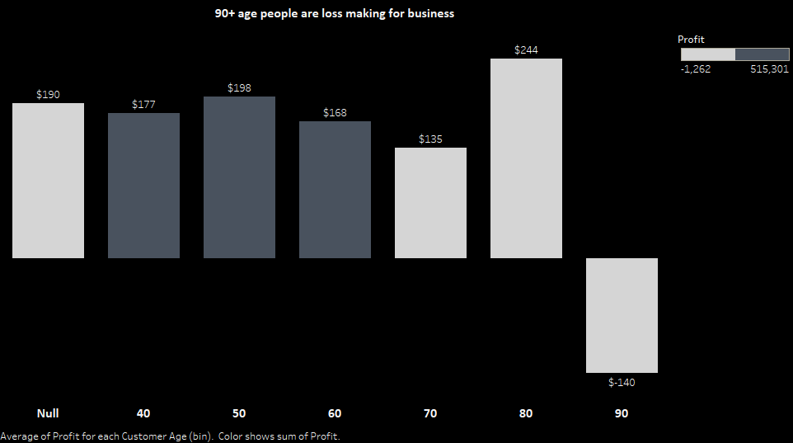

Slide 5


Slide 6
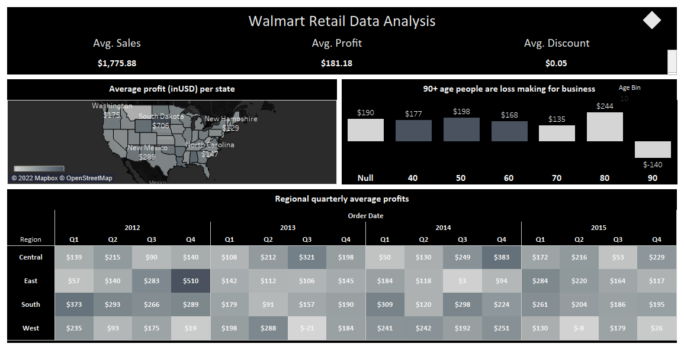

Slide 7
